Slide 1
Moulding Sand
Lecture 3

Slide 2
Molding sand classification
They can be classified as:
Natural molding sand (Green sand)
- Taken from river-beds & contain major amount of clay
- Easily available at low cost
Synthetic sand
- Contain little or no binder (clay)
- Strength & bonding property can be easily controlled
- More expensive than natural sand
Special sand
- Ideal in getting special characteristics.

Slide 3
Molding sand classification
Green Sand: Containing silica sand, clay, and water, possesses good strength and permeability.
Dry Sand: Stronger and more thermally stable than green sand, used for larger, heavier castings.
Loam Sand: A mixture with a high clay content (around 50%) and used for large castings with skeleton patterns.
Facing Sand: Used to form the mold face, providing a smooth surface for the casting to prevent metal penetration.

Slide 4
Molding sand classification
Backing Sand: Supports the facing sand and fills the rest of the mold cavity, contains permeability.
System Sand: Applied in machine molding, possessing high strength, permeability, and refractoriness.
Core Sand: Used to make cores and includes binders such as linseed oil, phenol-formaldehyde, urea-formaldehyde, dextrin, starch sodium silicate and fire clay.
Parting Sand: Used to prevent sand from sticking together at the parting line of the mold.

Slide 5
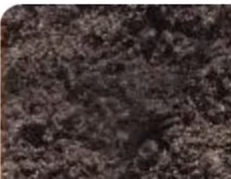
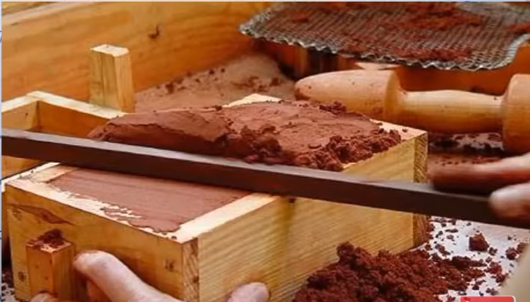
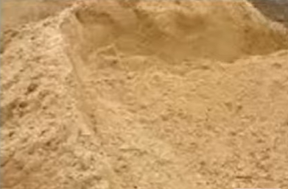
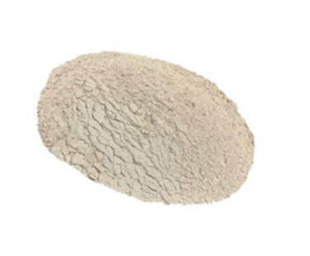
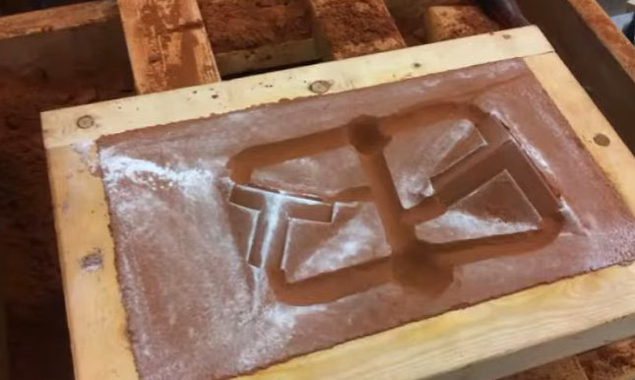
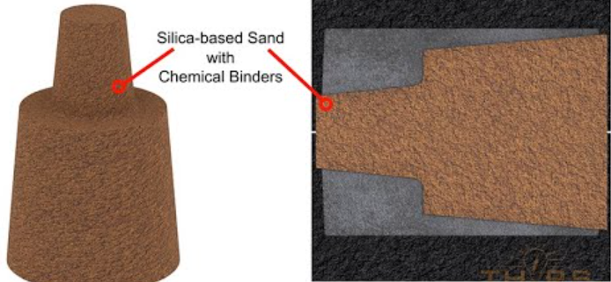
Types of Molding Sand
Green Sand
Dry Sand
Loam Sand
Parting Sand
Facing Sand
Core Sand

Slide 6
Sand preparation
Very few natural sands have all the qualities required by a molding sand
It is mixed with other sands which possess the required characteristics
Sufficient moisture must be added to the sand
Sand must be properly conditioned before use

Slide 7
Properties of a molding sand
Porosity (permeability): Sand must be porous to allow the gases/ moisture present within the molds to be removed freely when molten metal is poured.
Adhesiveness: Sand particles must be capable of adhering to sides of molding boxes.
Cohesiveness / Strength: Ability of sand particles to stick together and should be sufficient to permit the mold to be formed to the desired shape even after the hot metal is poured in the mold.
Refractoriness: Molding sands with a poor refractoriness may burn on to the casting. Measured by sinter point of sand.

Slide 8
Properties of a molding sand
Collapsibility: Mold made out of sand to collapse as the molten metal gets solidified in it.
Flowability: Ability of the sand to behave like a fluid so that, when rammed sand will flow to all portions of a mold and around the pattern and take up the required shape.
It increases as clay & water content increase.
High flowability is required of a molding sand of uniform density.
To obtain good impression of the pattern in the mold.

Slide 9
Key components of sand
Silica Sand: The base material of the mold. Typically silica sand.
Clay: Binds the sand particles together, providing strength and durability to the mold. Bentonite, Kaolinite etc.
Water: Essential for the binding properties of clay in green sand.
Binders (Resins): Used in dry sand or resin sand casting to create a strong, solid mold e.g. phenolic resins, furan resins, urea resins, epoxy resins and acrylic resins.
Auxiliary Substances: May include sawdust, coal powder, or straw, improving air permeability and heat resistance of the mold

Slide 10
Key components of sand
Silica sand (SiO₂): Act as the primary mold material provides refractoriness, typical range is 80-92%.
Clay: Acts as a binder, common types include bentonite clay (e.g., sodium bentonite), typical range is 6-12%.
Water: Activates the clay binder, enabling it to hold the sand grains together, typical range is 3-6%.
Other additives: Include sea coal, silica flour, and other organic materials. They improve flowability, permeability of the mold and surface finish of the casting.

Slide 11
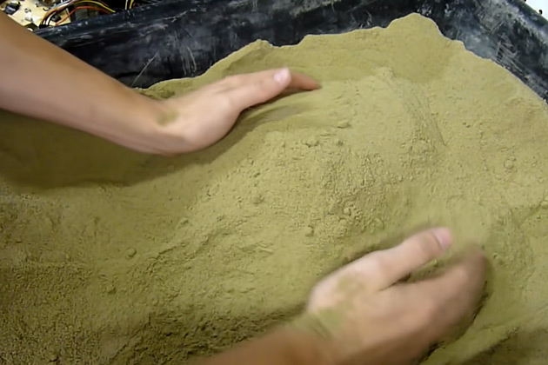
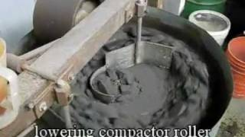
Sand mixing

Slide 12
Green sand mold

Slide 13

Green sand mold
with pattern
Drag
Drag
Drag
Drag
Pattern
Pattern
Molding board
Molding board
Molding board
Molding board
FIRST OPERATION
FIRST OPERATION
Vents
Weight
Lifter
Riser pin
Sprue pin
Pouring basin
Cope
Riser
Parting
line
Parting
line
Runner
Gate
Core
SECOND OPERATION
COMPLETE MOLD

Slide 14
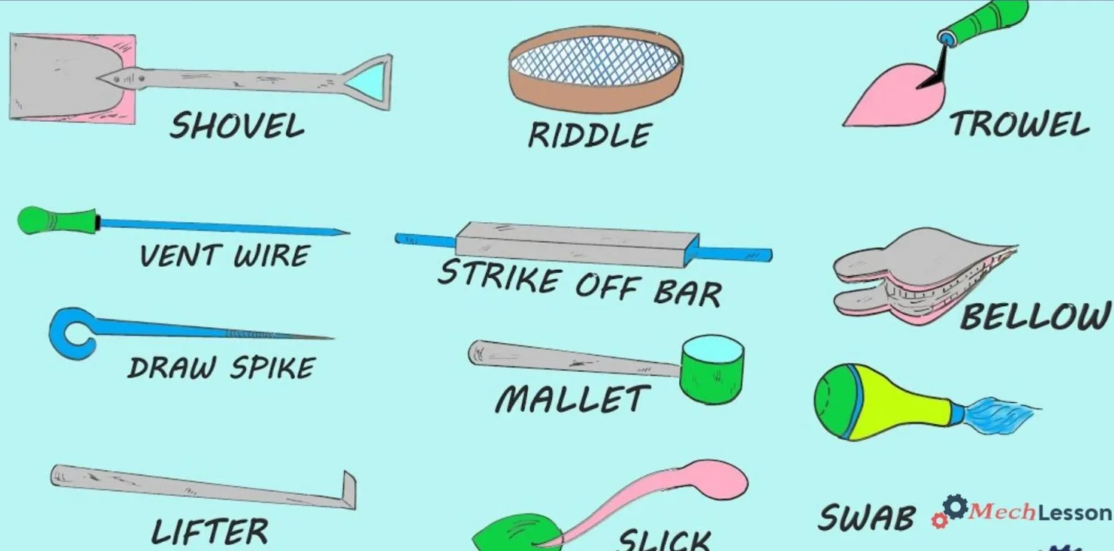
Molding tools
LINK: https://www.youtube.com/watch?v=FihNxujyu08

Slide 15
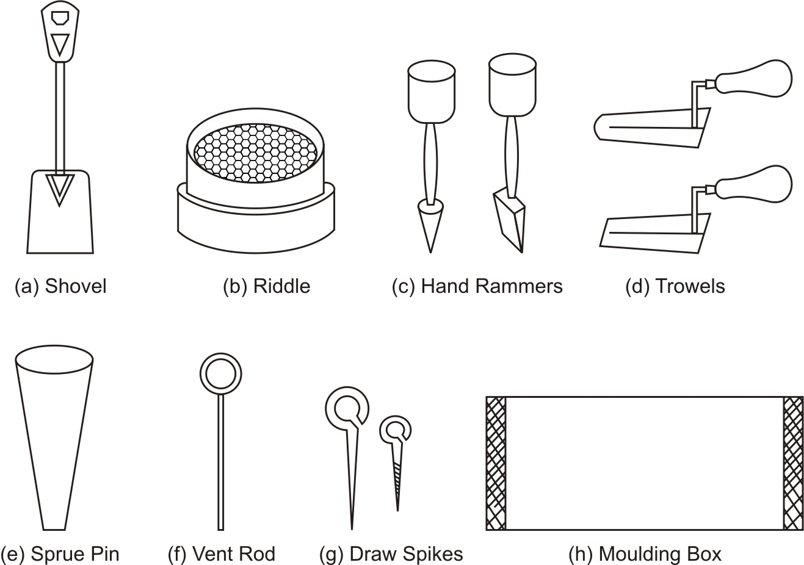

Slide 16
11

